Slide 1
Game based Aptitude
VIGNESH M

Slide 2
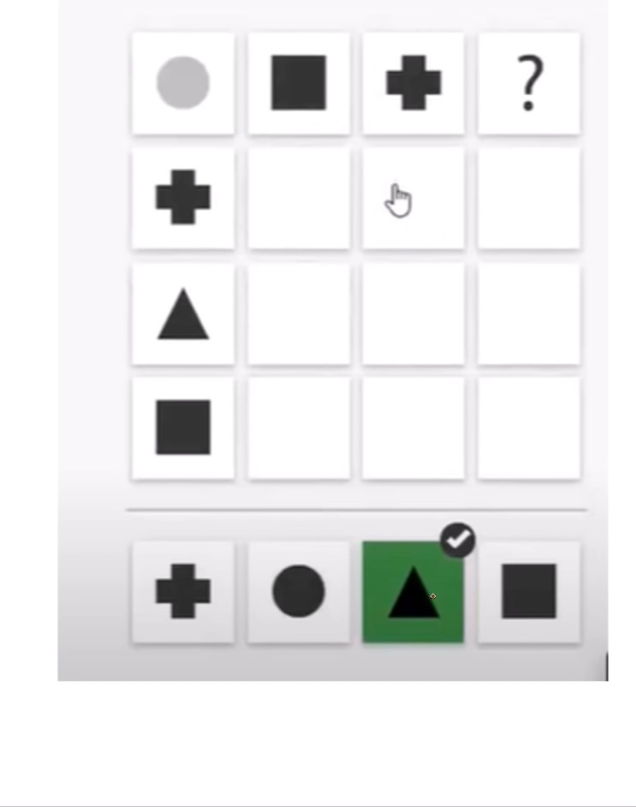

Slide 3
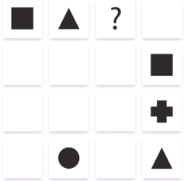




1.Find the missing part.
(a) (b)
(c) (d)

Slide 4
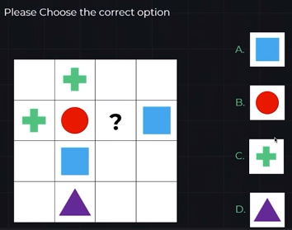

2. Please choose the correct option.
(a) (b)
(c) (d)

Slide 5
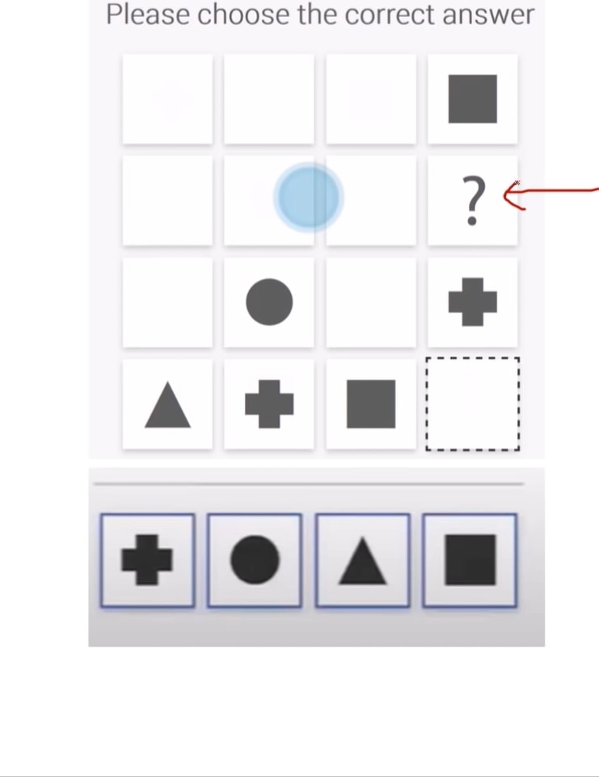

Slide 6
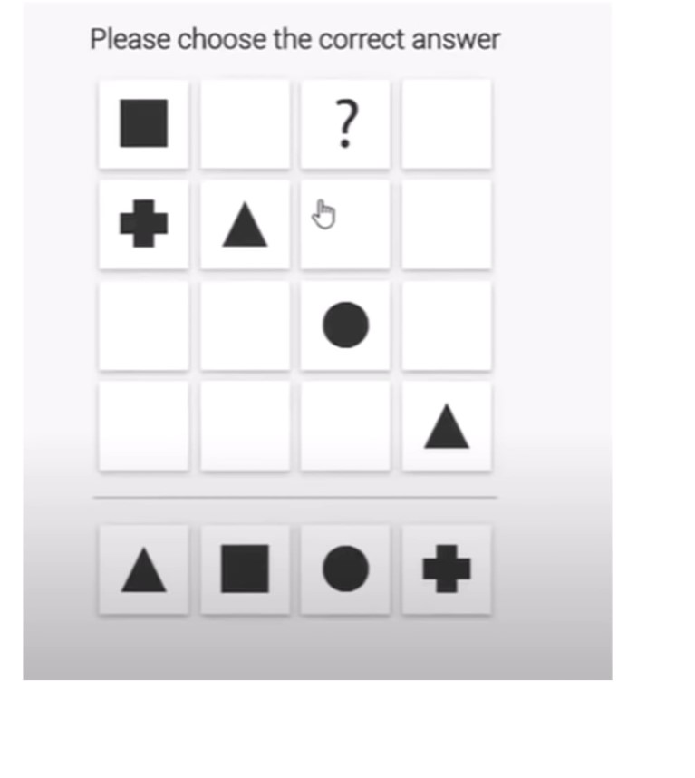
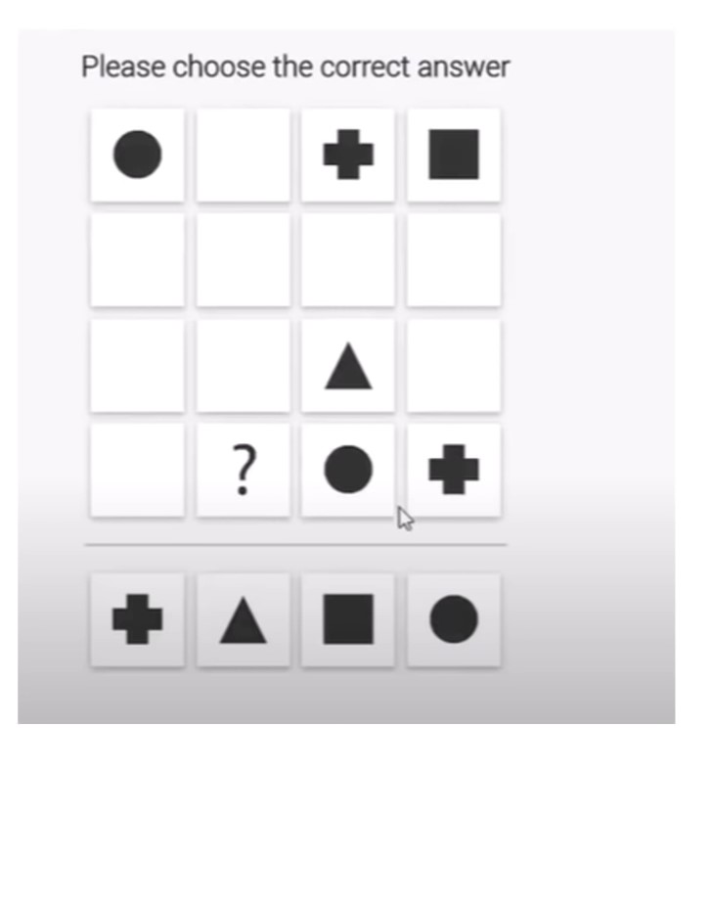

Slide 7
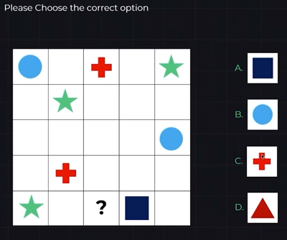

4. Please choose the correct option.
(a) (b)
(c) (d)

Slide 8
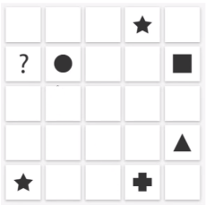





5. Find the missing part.
(a) (b)
(c) (d)
(e)

Slide 9
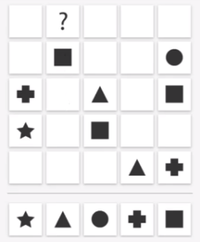





6. Find the missing part.
(a) (b) (c)
(d) (e)

Slide 10
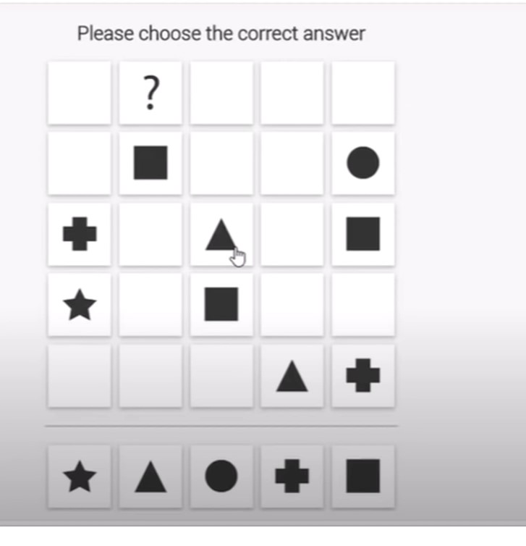
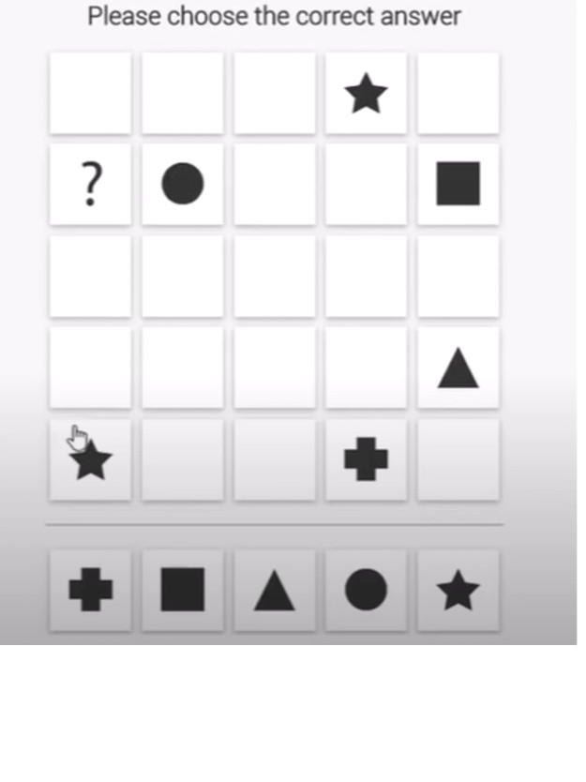

Slide 11
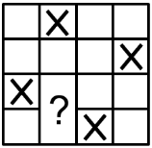
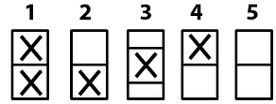
3.Find the missing part
(a) 1 (b) 2 (c) 3
(d) 4 (e) 5

Slide 12

7. Pick the odd one.

Slide 13
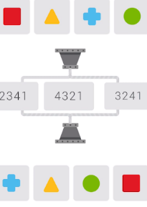
8. Identify the order of rearrangement.
(a) 2341 (b) 4321
(c) 3241 (d) None of these

Slide 14
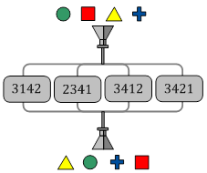
9. What is the function of the funnel used here?
(a) 3142 (b) 2341 (c) 3412 (d) 3421

Slide 15
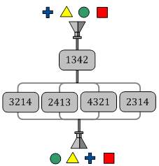
10. What is the function of the funnel used here?
(a) 3214 (b) 2413 (c) 4321 (d) 2314

Slide 16
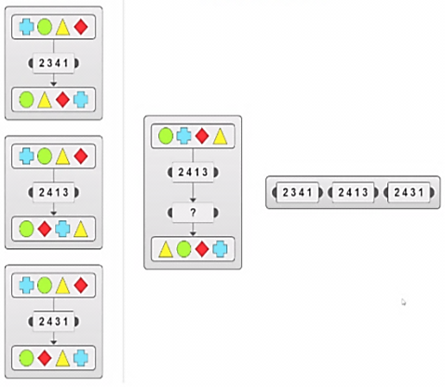
11. Which operator is needed?
Operator
(a) 2341 (b) 2413
(c) 2431 (d) None of these

Slide 17
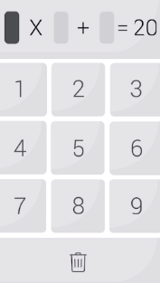
12. Enter the unique digits that satisfy the given equation.

Slide 18
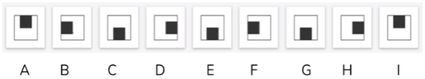
13. Pick the one that doesn’t fit the group.

Slide 19
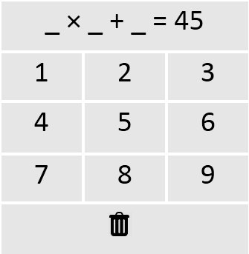
14. Enter the unique digits that satisfy the given equation.

Slide 20
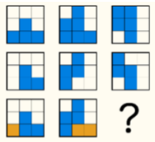






15. Find the missing part.
(a) (b) (c)
(d) (e) (f)

Slide 21
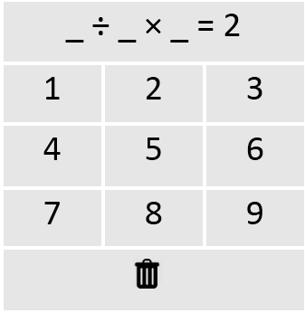
16. Enter the unique digits that satisfy the given equation.

Slide 22
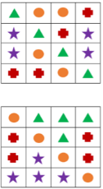








17. These two grids follow a rule.
Which two of these grids follow the same rule?
(a)
(b)
(c)
(d)

Slide 23
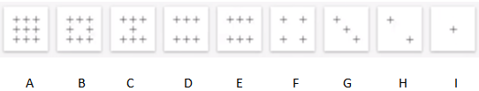
18. Pick the one that doesn’t fit the group.

Slide 24
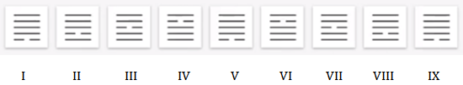
19. Pick the one that doesn’t fit the group.
(a) I (b) II (c) III
(d) IV (e) V (f) VI
(g) VII (h) VIII (i) IX

Slide 25
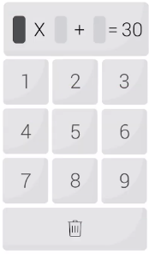
20. Enter the unique digits that satisfy the given equation.

Slide 26

21. Pick the one that doesn’t fit the group.

Slide 27







22. These two grids follow a rule.
Which two of these grids follow the same rule?
(a)
(b)
(c)
(d)

Slide 28
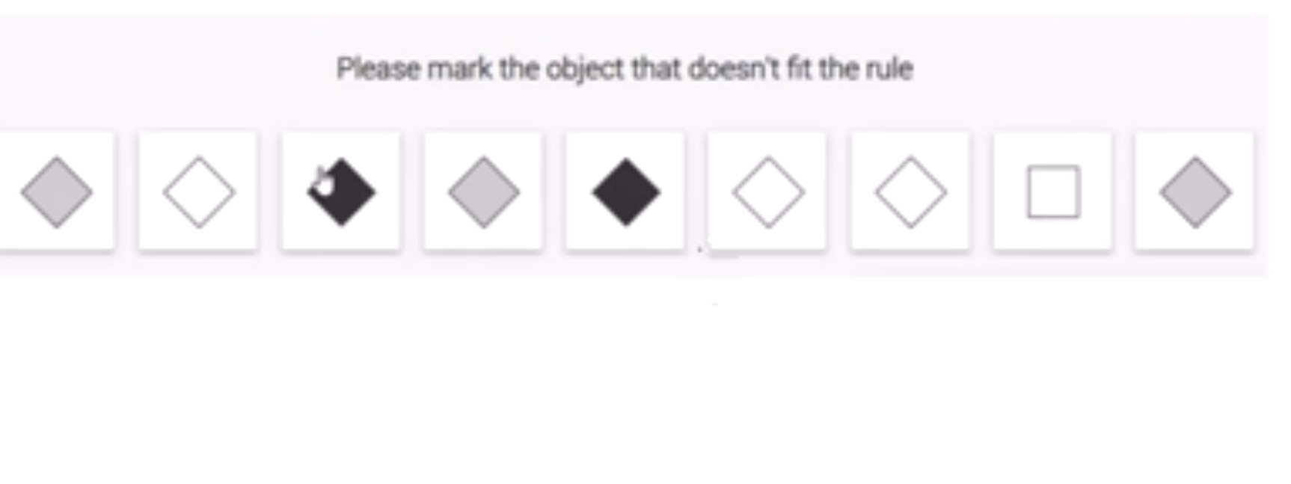
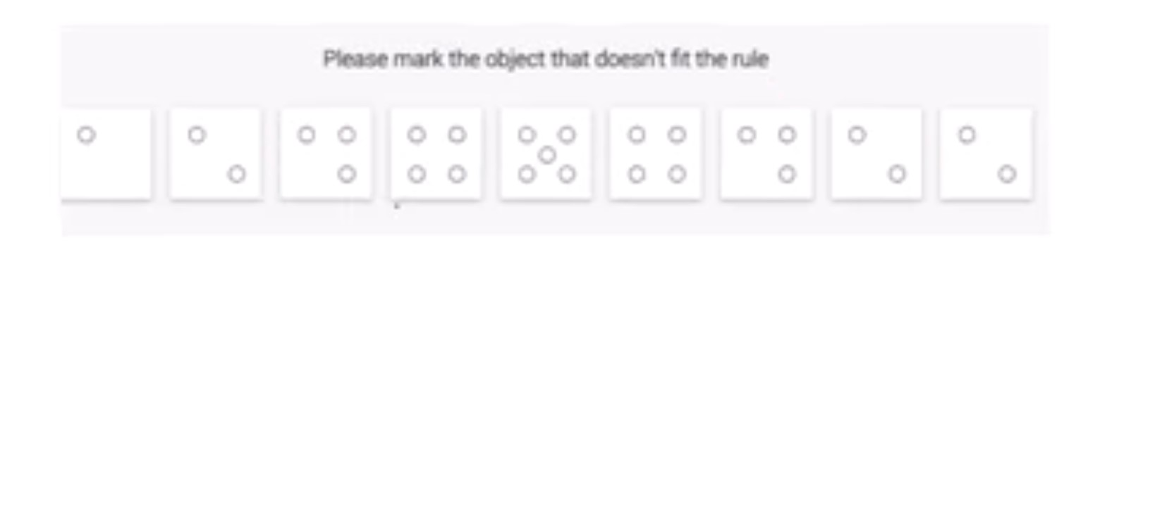

Slide 29
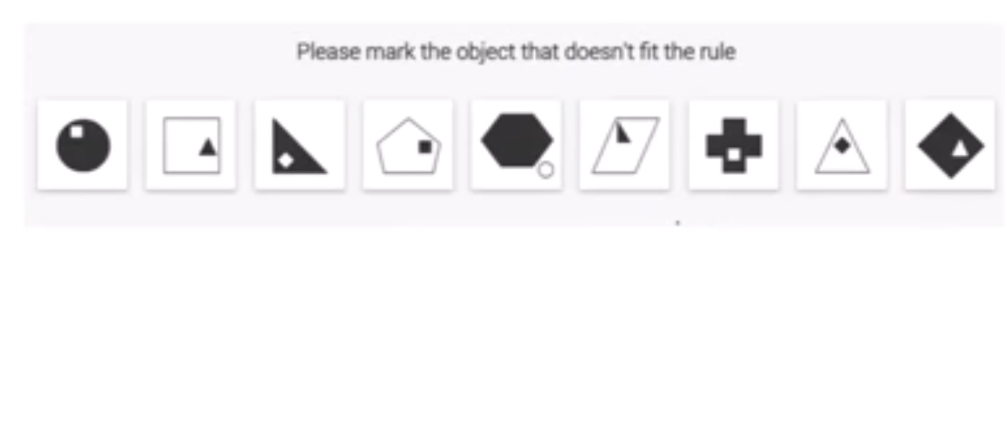

Slide 30
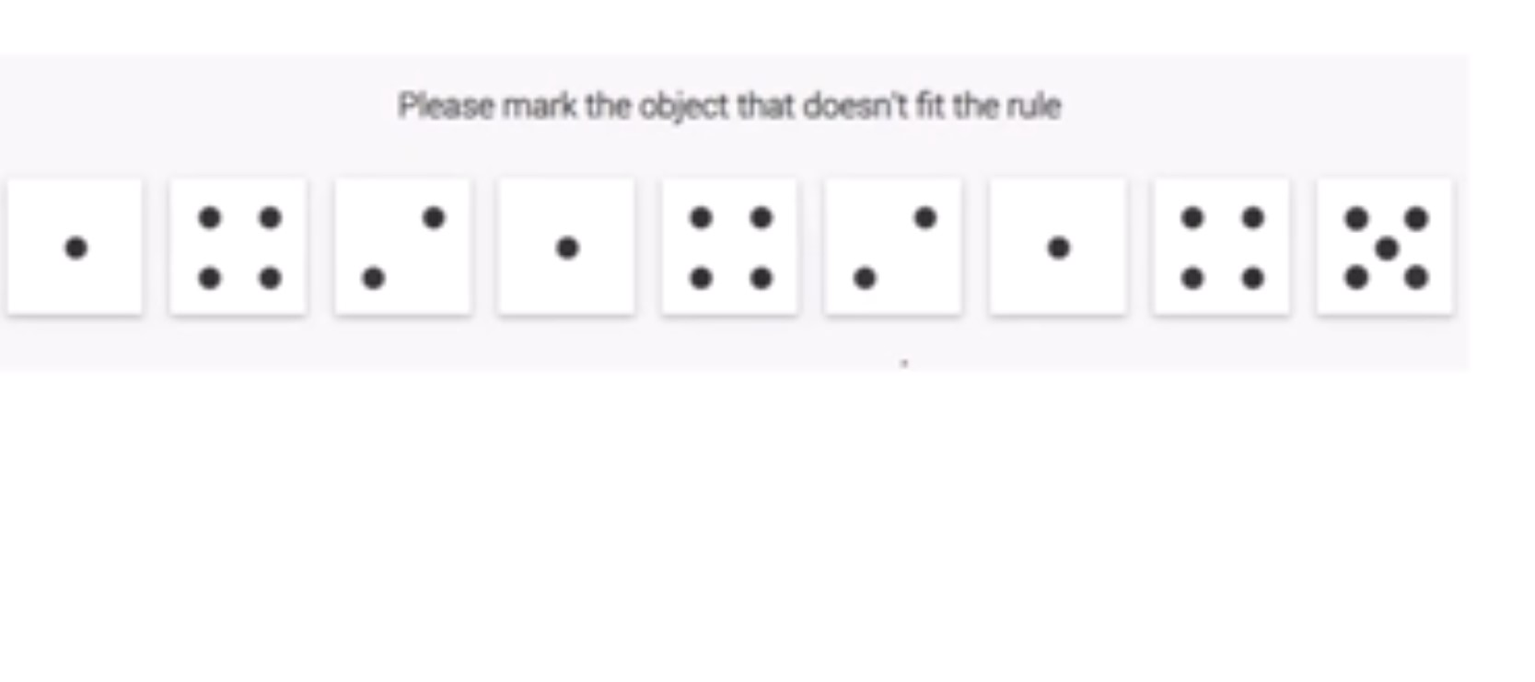

Slide 31
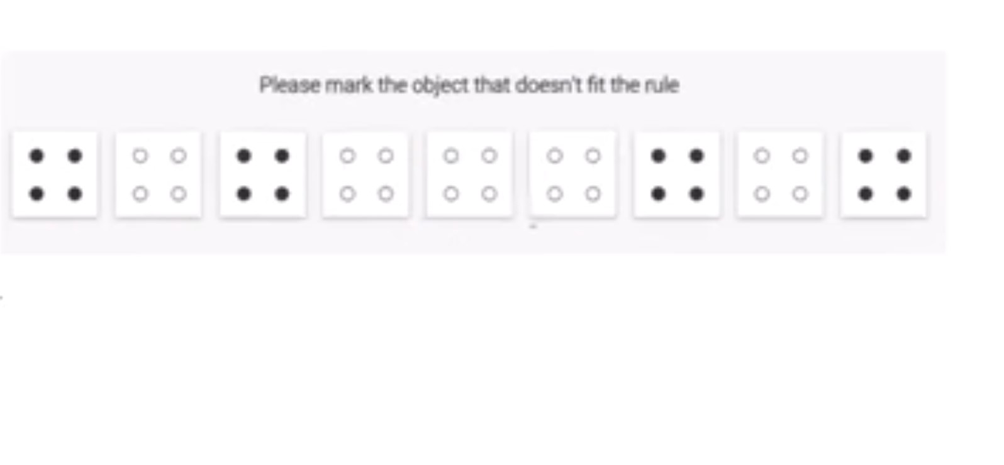

Slide 32
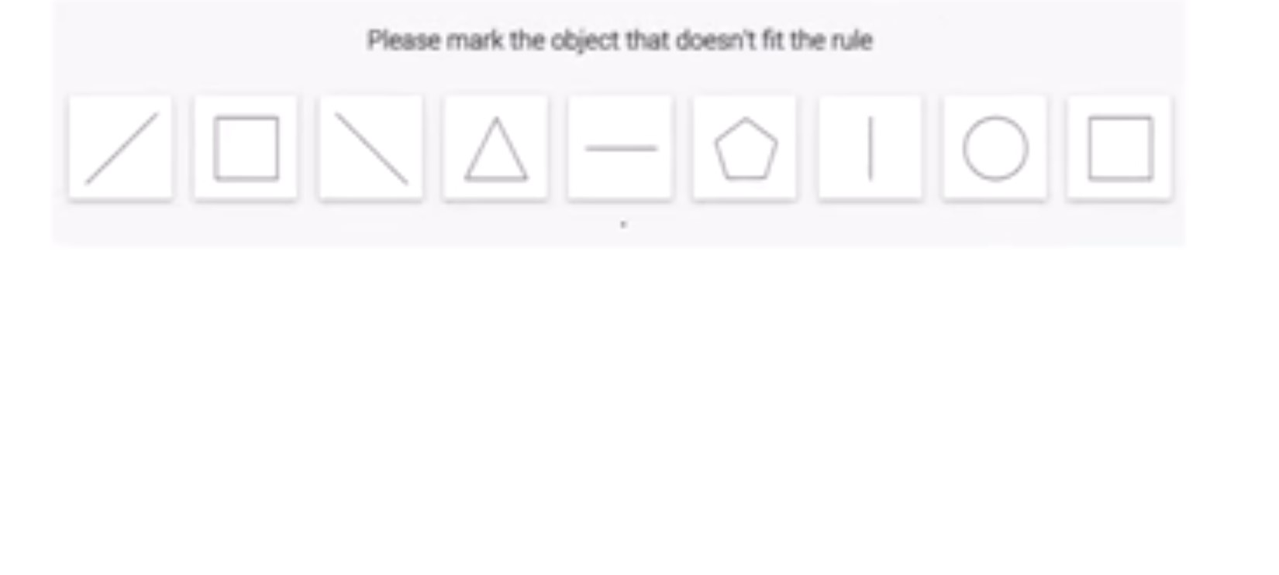

Slide 33
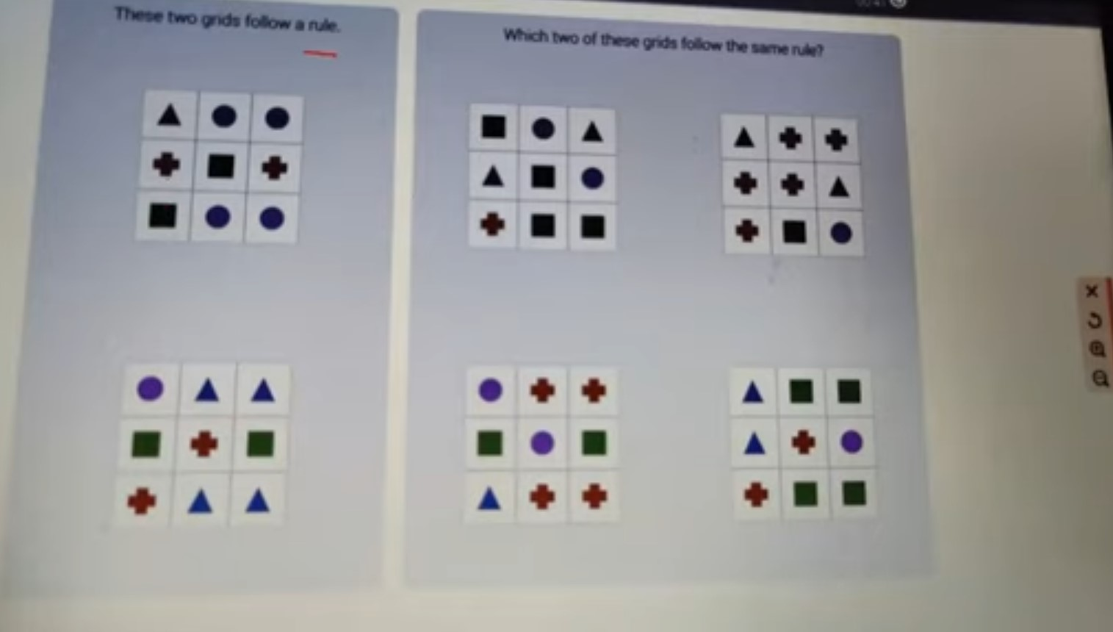

Slide 34
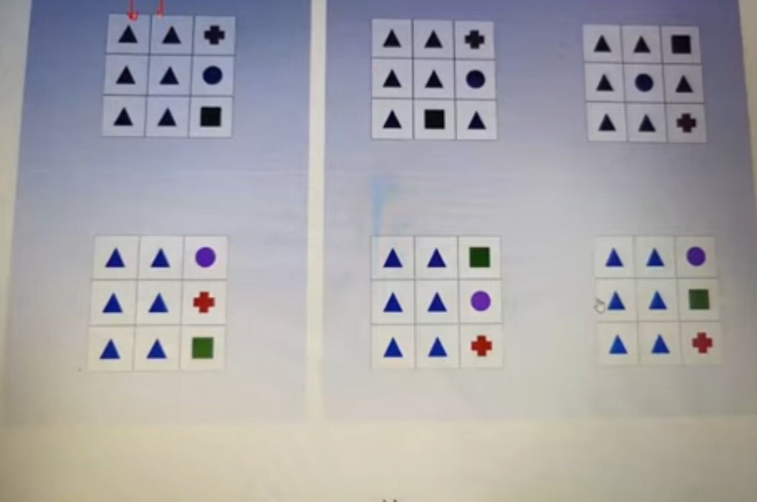

Slide 35
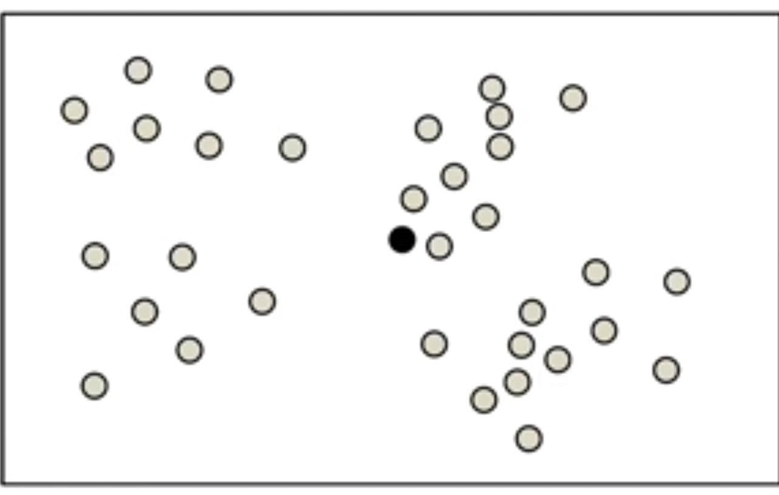

Slide 36
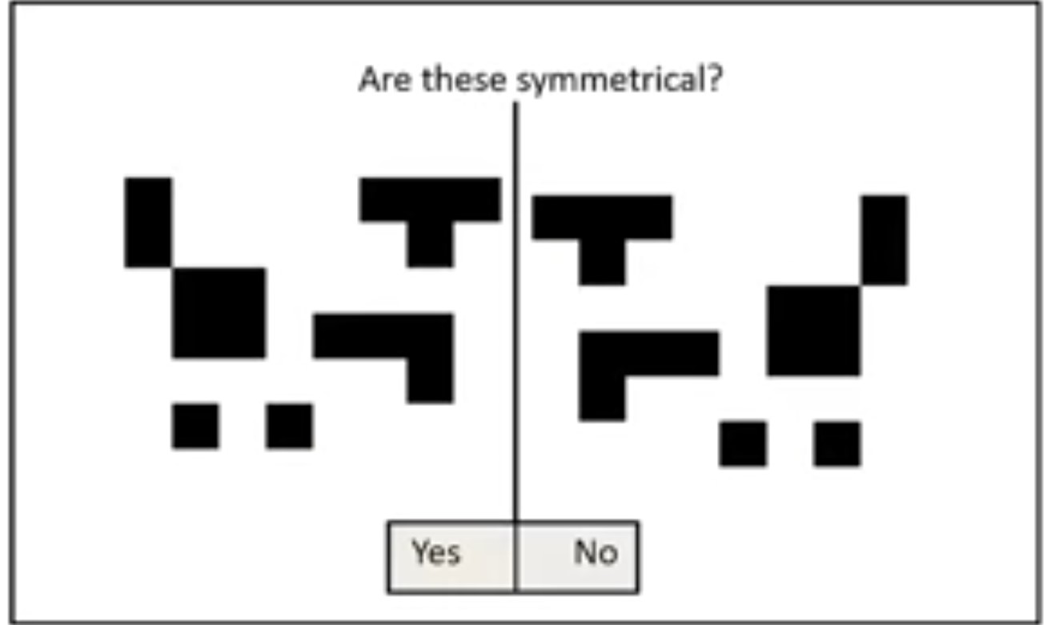

Slide 37
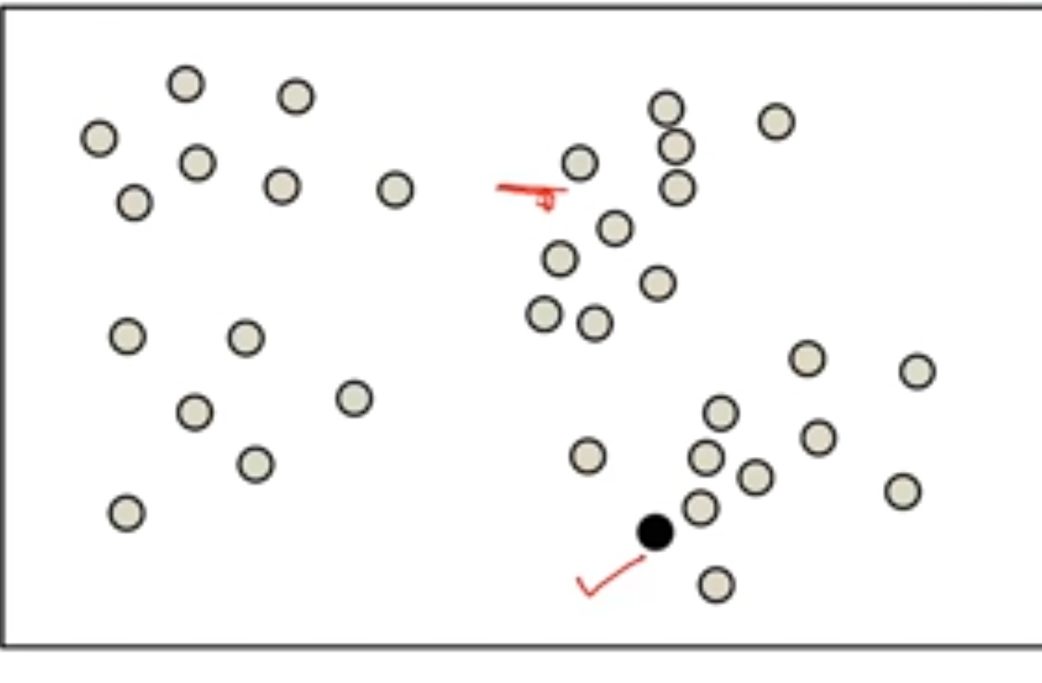

Slide 38
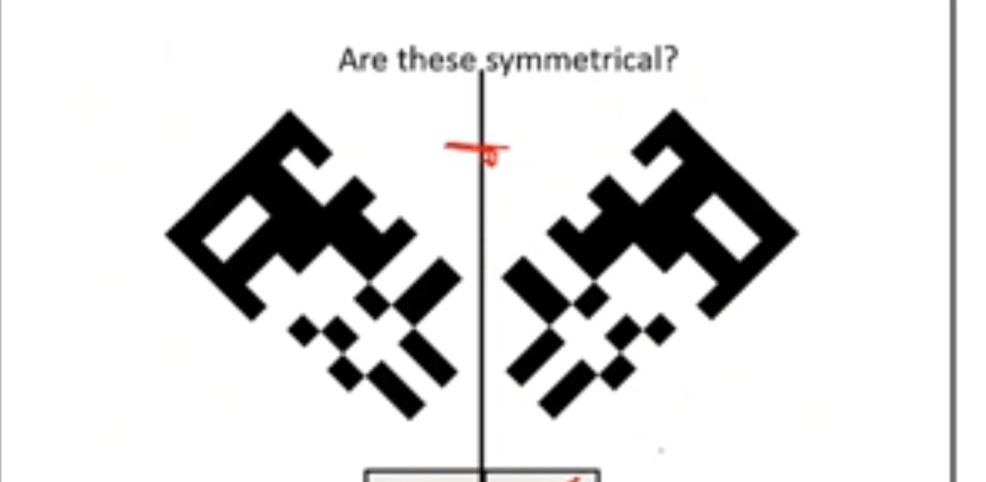

Slide 39
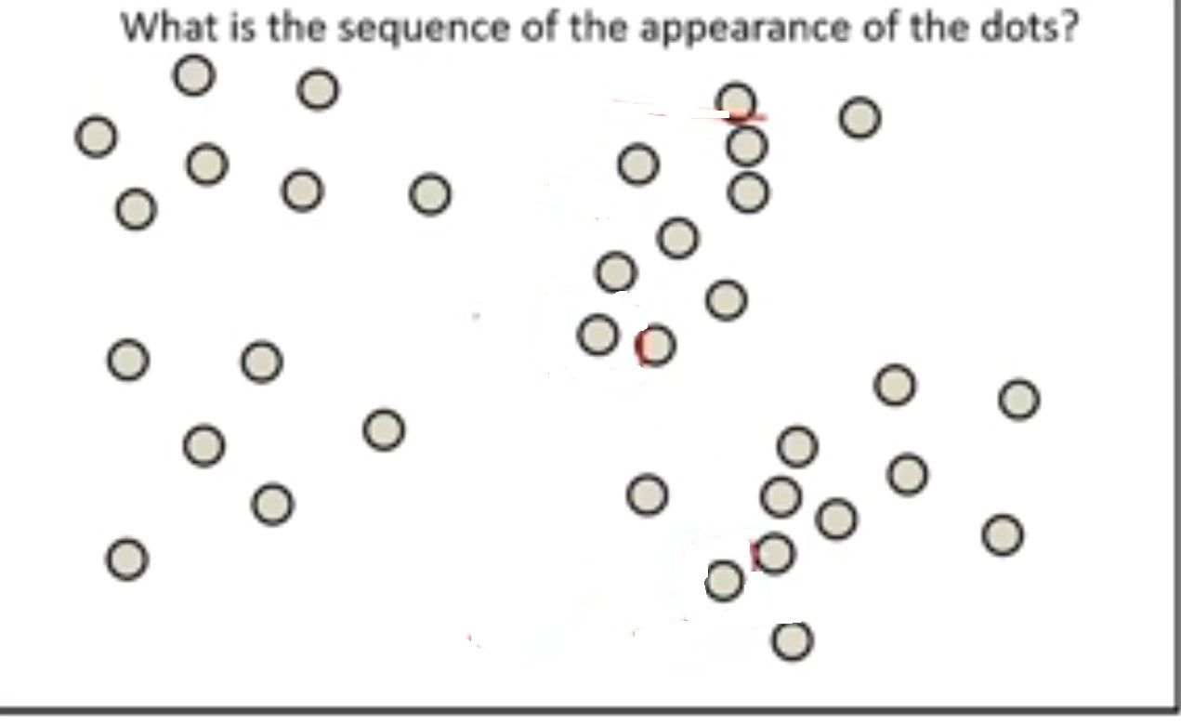

Slide 40
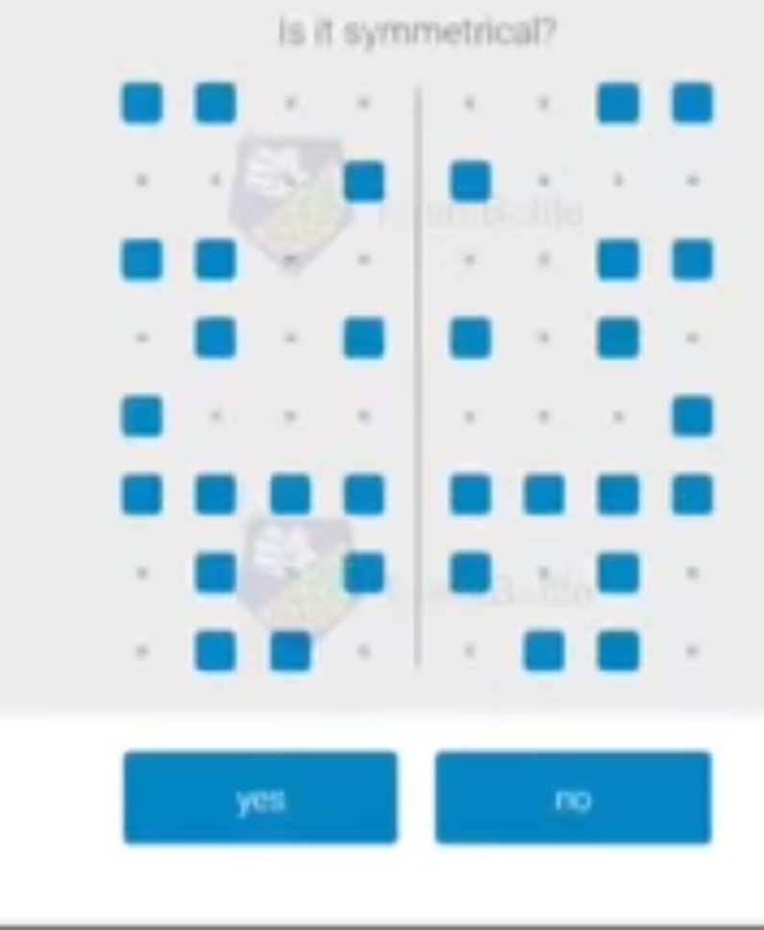

Slide 41
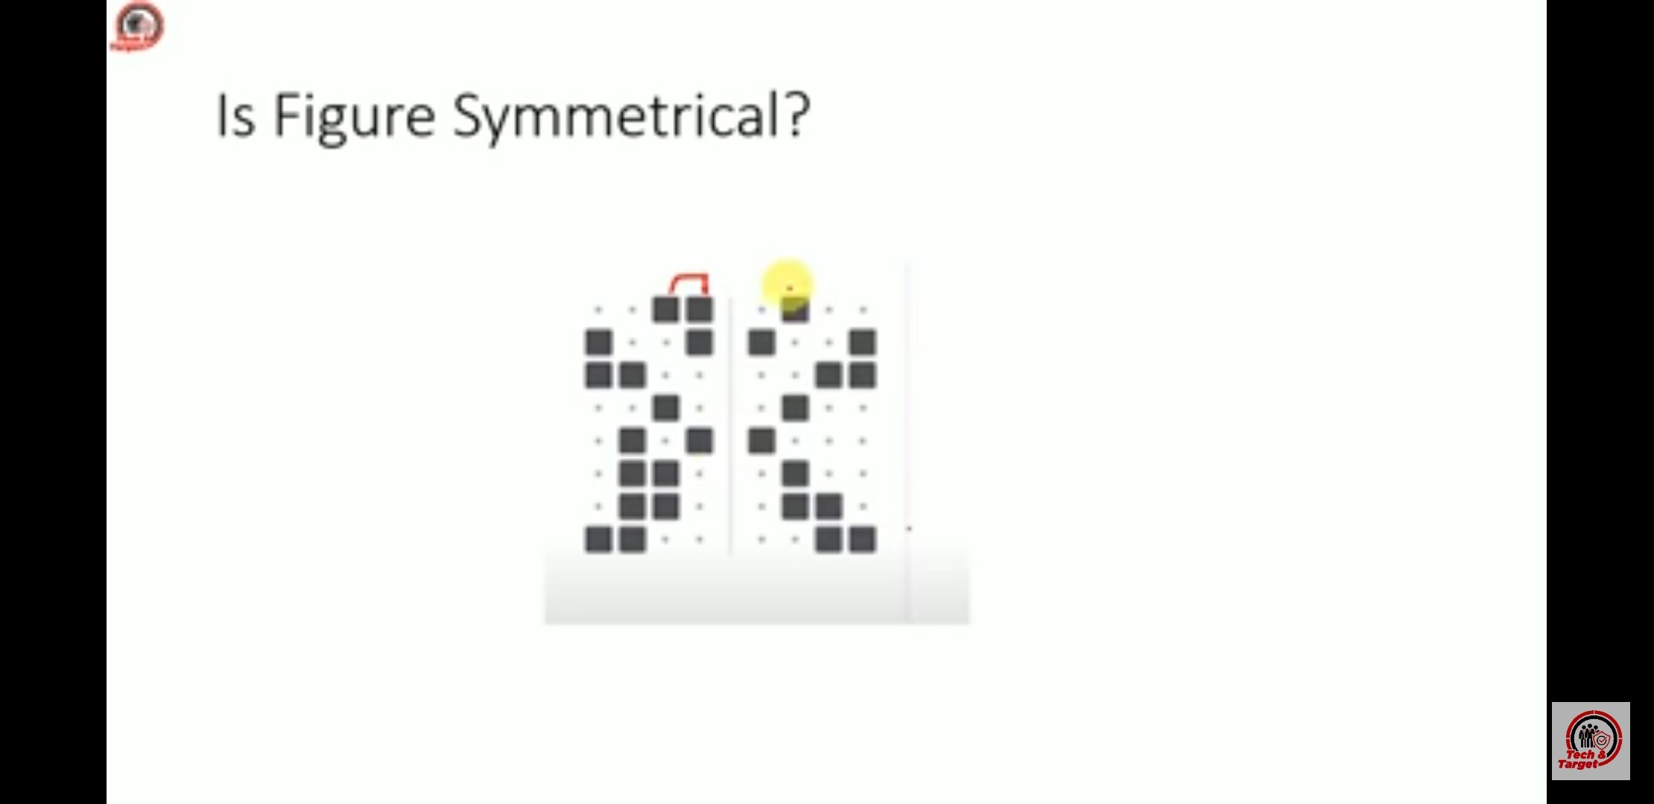

Slide 42
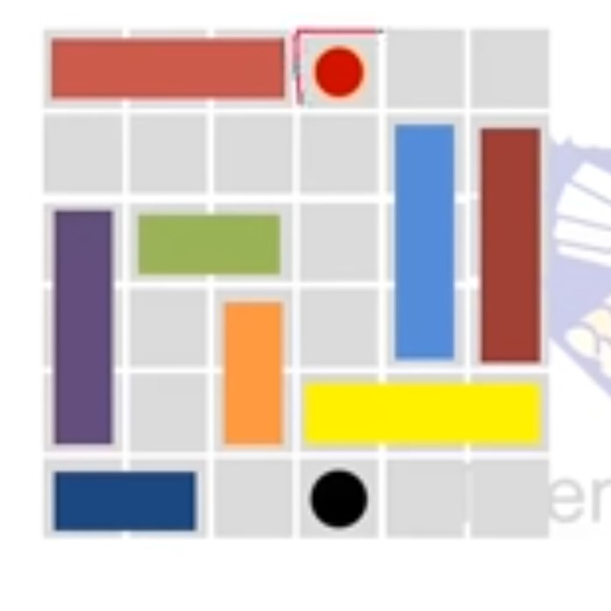

Slide 43
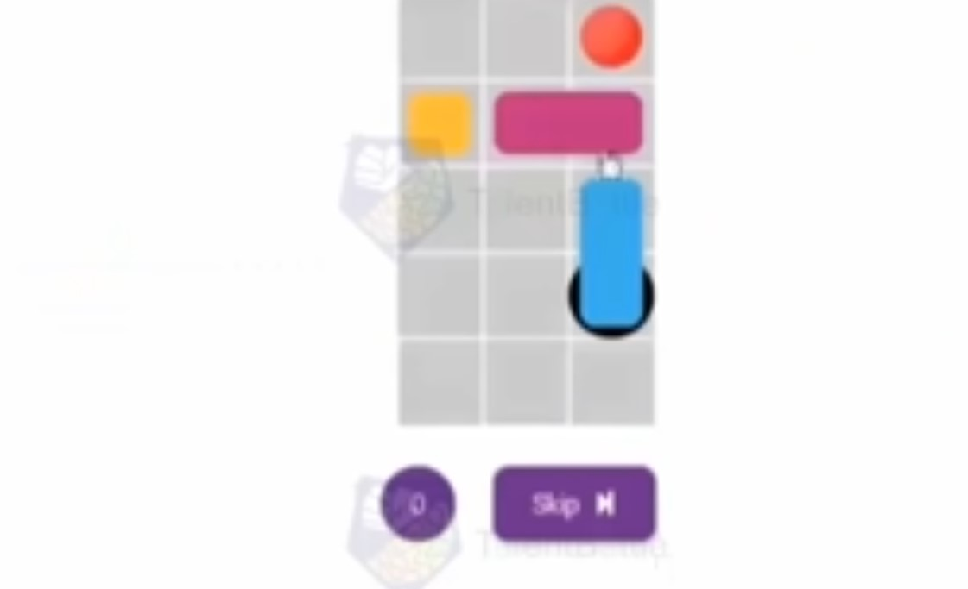

Slide 44
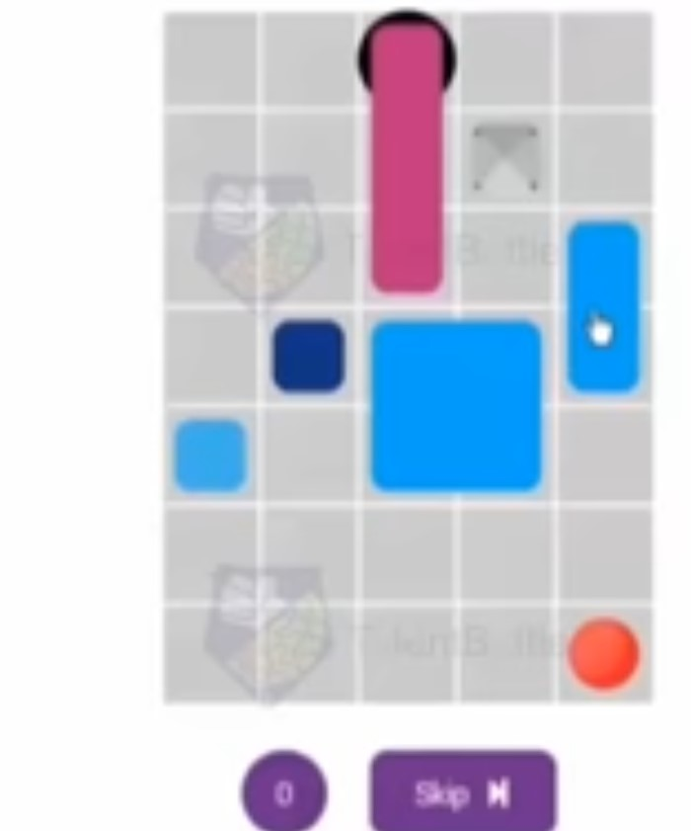

Slide 45
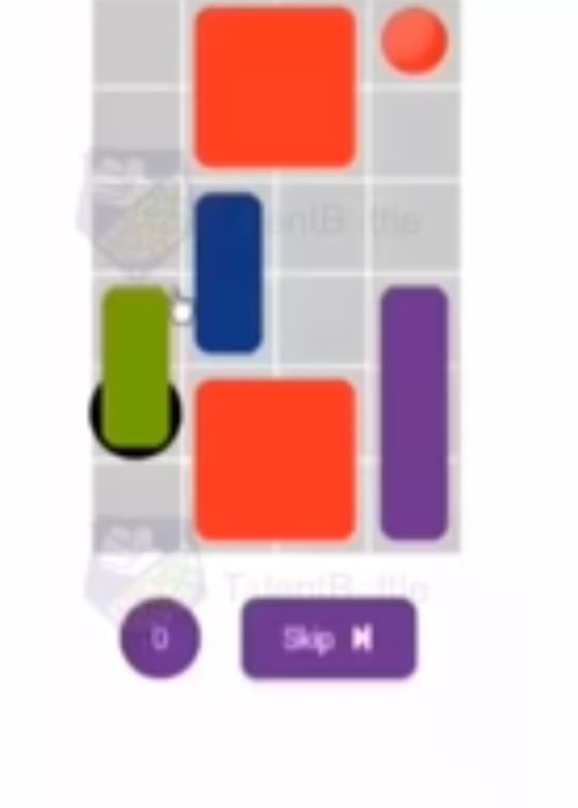

Slide 46
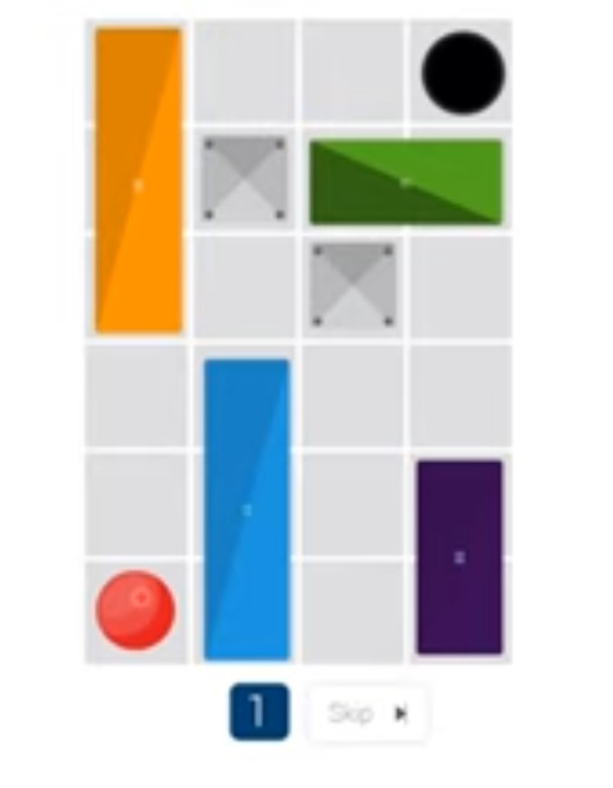

Slide 47
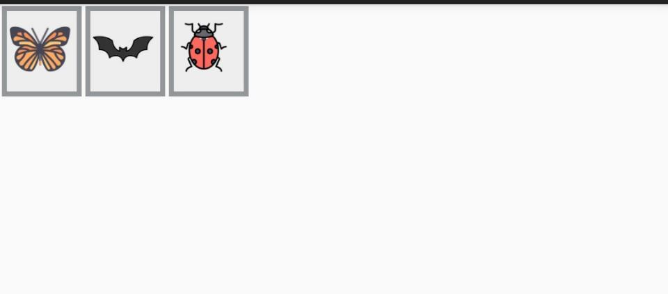
Take 5 seconds

Slide 48


23.

Slide 49
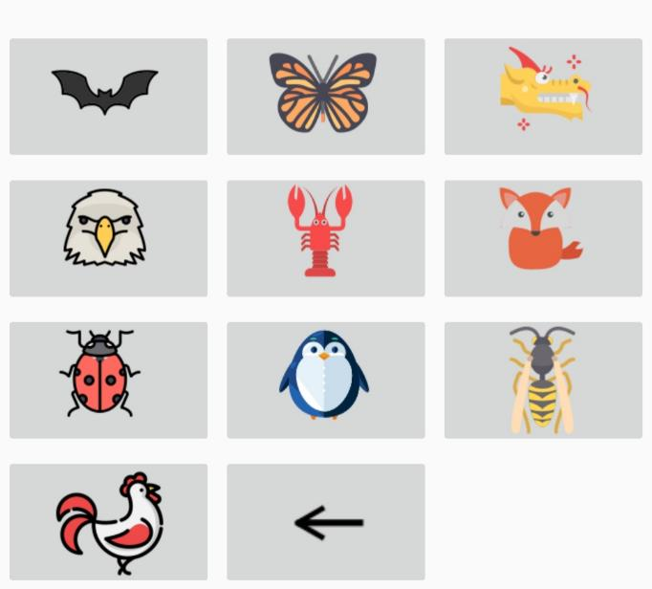

Slide 50
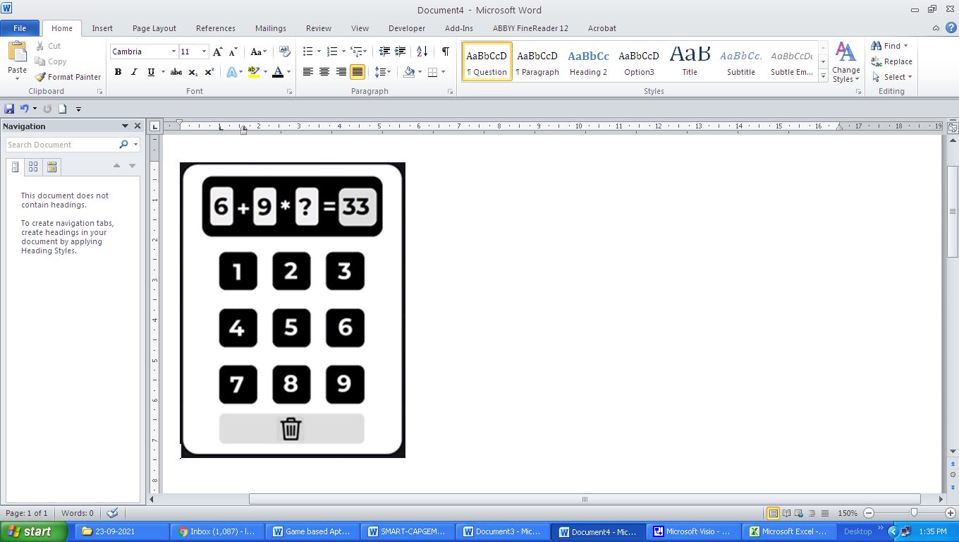
24. Solve the following equation.
(a) 3 (b) 2 (c) 4 (d) 5

Slide 51
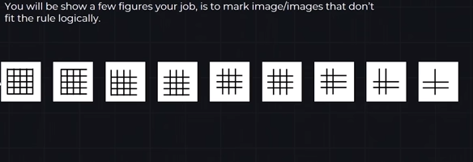
40. You will be show a few figures your job, is to mark image/images that don’t fit the rule logically.

Slide 52


Slide 53

25. You will be shown a few figures, your job is to mark other set of image/images that fit the same rules.
Fits the rule challenge
These two grids follow a specific rule
Which of these groups follow the same rule?
(a) Image 1 (b) Image 2
(c) Image 3 (d) Image 4

Slide 54


Slide 55


Slide 56

1.
(a) (b)
(c) (d)

Slide 57


Slide 58



Slide 59



Slide 60


Slide 62


Slide 64

2.
(a) (b)
(c) (d)

Slide 65

3.
(a) (b)
(c) (d)

Slide 66

4.
(a) (b)
(c) (d)

Slide 67

5.
(a) (b)
(c) (d)

Slide 68

6.
(a) (b)
(c) (d)

Slide 69

7.
(a) (b)
(c) (d)

Slide 70

8.
(a) (b)
(c) (d)

Slide 71

9.
(a) (b)
(c) (d)

Slide 72

10. Take 5 seconds

Slide 73


Slide 74

11.
(a) (b)
(c) (d)

Slide 75

12.
(a) (b)
(c) (d)

Slide 76

13.
(a) (b)
(c) (d)
(e) (f)

Slide 77

14. Take 5 Seconds

Slide 78


Slide 79

15. Take 5 seconds

Slide 81
THANK YOU

